Slide 1
Subject: Multimedia Computing & Technology Chapter-6 Optical Storage Media
By: Er. Ramesh Basaula

Slide 2
Contents
6. Optical Storage Media
6.1 Basic technology
6.2 Video disk fundamentals
6.3 CD audio, CD ROM and extended Architecture
6.4 Principles of CD Write-Once and CD Magneto Capital.

Slide 3
6.1 Basic technology
Optical Storage Media
This type of storage media uses light .
In the optical storage devices, all read and write activities are performed by light.
A laser beam is the usual light source.
All recording information stores at an optical disk.
It offers a higher storage capacity at a lower cost.
Example:
CD
DVD, etc.

Slide 4
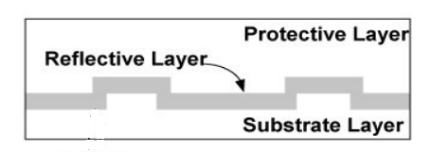
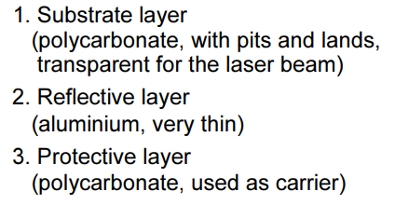
Land
Pit
Figure: Layers in Optical Storage Media
Substrate layer is covered with a thin reflective layer.

Slide 5
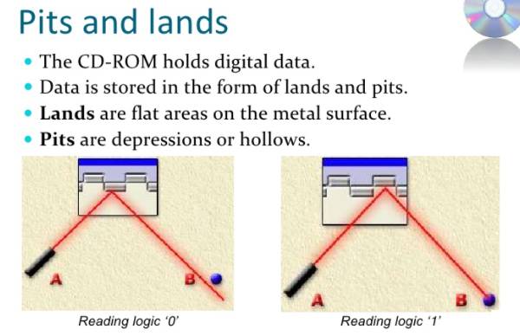

Slide 6
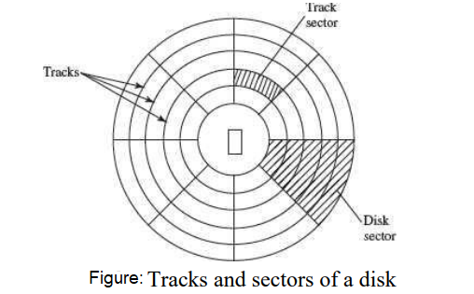
Data in disk are divided into track.
Tracks are further divided into sectors.

Slide 7
Advantages of Optical Storage Devices:
It is capable to store large amount of data.
Affordable price
It can be recycled (Re-used).
It has ultra data stability.
Best Durability, Transport-ability, and archiving.
Disadvantages Optical Storage Devices:
Some traditional PCs are not able to read these disks.
Difficult to recycle.

Slide 8
6.2 Video disk fundamentals
It is a general term for a laser- vision, serves as the output of motion pictures and audio.
Data are stored in an analog-coded format on the disk.
Typically, it is a reference to any such media that predates the mainstream popularity of the DVD format.
It was designed as ROM, many different write-once optical storage systems have come out, known as WORM disk.
Example: CD, DVD, etc.

Slide 9
Write once read many (WORM)
It describes a data storage device in which information, once written, cannot be modified.
Concept: write once, read many
WORM protects the important files by keeping them safe and intact.
It ensures the highest level of integrity and data security by eliminating the risk of important data from being deleted or modified.
This way, the WORM helps to preserve the authenticity and safety of recorded data.
Examples:
CD-R (Compact Disc- Recordable)
DVD-R (Digital Versatile Disc-Recordable)

Slide 10
6.3 CD audio, CD ROM and extended Architecture
CD-audio/ CD-Digital audio (CD-DA):
Also known as Audio CD.
It is the standard format for audio compact discs.
The format was originally developed to store and play only digital audio recordings (CD-DA) but was later adapted for storage of data (CD-ROM).
It was developed by Sony and Philips in the 1980s and is defined in the Red Book standard.
CD-DA consists of 3-areas:
Lead-in area= includes directory of CD-DA.
Program area= includes all tracks of CD-DA.
Lead-out area= used to help the play recorder when the reader head accidently goes beyond the program area.

Slide 11
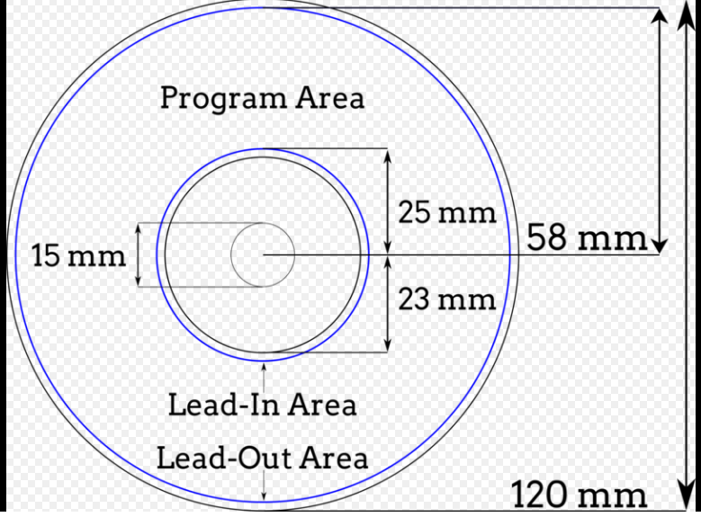
This image of a CD-R demonstrates some of the visible features of an audio CD, including the lead-in, program area, and lead-out.
A microscopic spiral of digital information begins near the disc's center and progresses toward the edge.
The end of the data region and the lead-out can actually be anywhere, depending on how much data is recorded.
Data-free areas of the disc and silent portions of the spiral reflect light differently, sometimes allowing track boundaries to be seen.
Notes:
Hub , clamping area

Slide 12
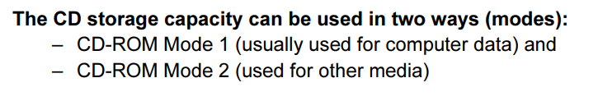
CD-ROM
“Compact Disc Read-Only Memory.”
Data on the disc is "read-only," or cannot be altered or erased.
It is an optical disc that contains audio or software data whose memory is read-only.

Slide 13
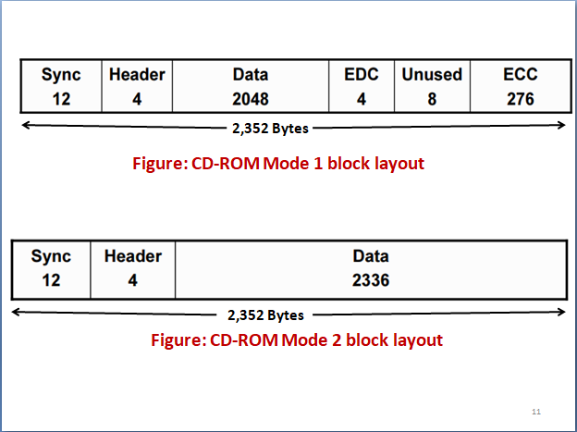
Here,
EDC= Error detection and correction
ECC= Error correcting code

Slide 14
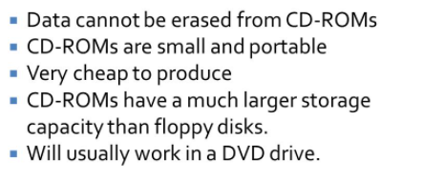
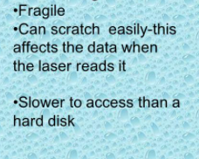
Advantages of CD-ROM:
Disadvantages of CD-ROM:

Slide 15
Assignment:
Write advantages and disadvantages of CD.
Explain working principle of CD-ROM (describe read and write processes.)
Compare CD and DVD.

Slide 16
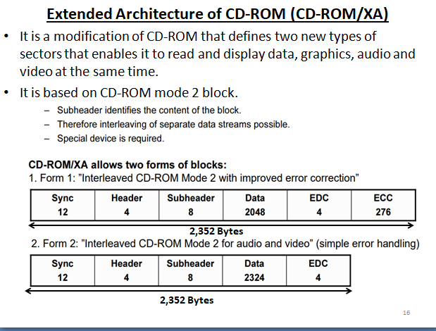

Slide 17
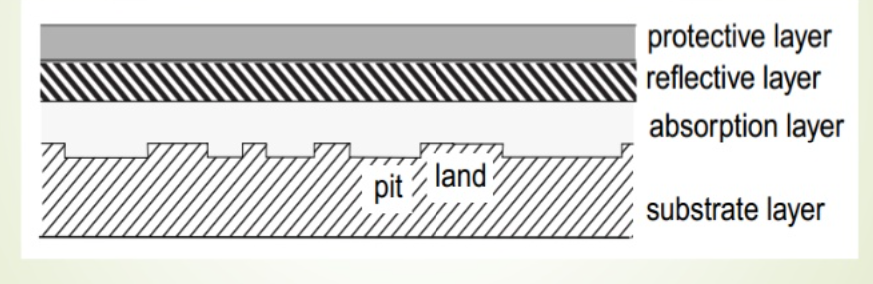
6.4 Principles of CD Write-Once and CD Magneto Capital
CD Write-Once (CD-WO)
It is similar to the CD-R.
Figure: Cross-section of CD-WO disk

Slide 18
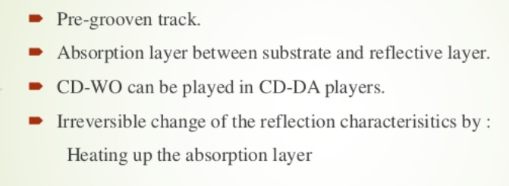
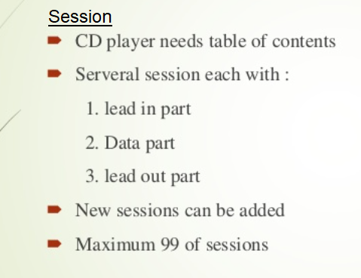
Principle of CD-WO:

Slide 19
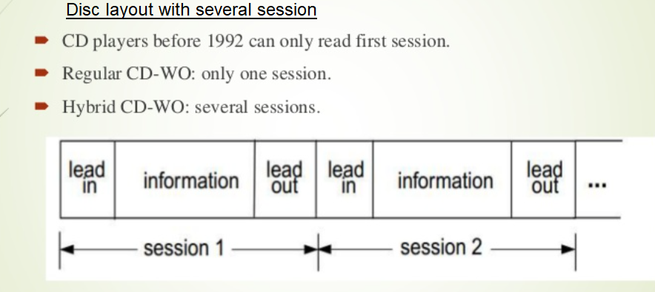

Slide 20

CD Magneto Capital

Slide 21


Principle of CD-MO:
CD-MO is based on the polarization of magnetic field where the polarization is caused by a heat.
Polarization is a property of waves that can oscillate with more than one orientation.

